Slide 1

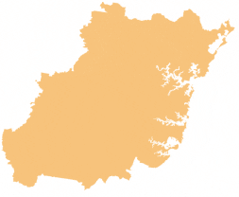

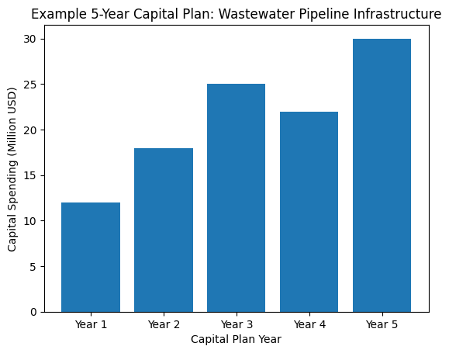
EXAMPLE WATER UTILITY
About EWD
Suggested information to include to orient attendees with your utility
Population served and/or service area
Length of watermains, # pressure zones
Length of wastewater sewers
Total asset value
Average day water supply
About EWD
Capital Plan Overview
Highlight 5-10 Year Horizon for CIP, emphasizing trenchless needs. Include Graphs if available. Highlight Key challenges & priorities related to trenchless (aging infrastructure, growth, regulations, workforce, etc.)
Priority Trenchless Projects
Projects | Procurement Type | Procurement Timeline | Diameter | Length
Distribution Watermain Rehab Program | Construction Tender | Q4 2026 | 12”-16” | 2 miles
New Creek Interceptor | Design Tender | Q1 2027 | 54” | 1 mile
Sewer System Evaluation Survey | Study | Q3 2026 | <24” | 15 miles
Existing Interceptor Rehab | Collaborative Delivery | Q2 2027 | 98” | 2 miles
Watermain Break Reduction Study | Study | Q2 2026 | 12”-16” | 20 miles

Slide 2
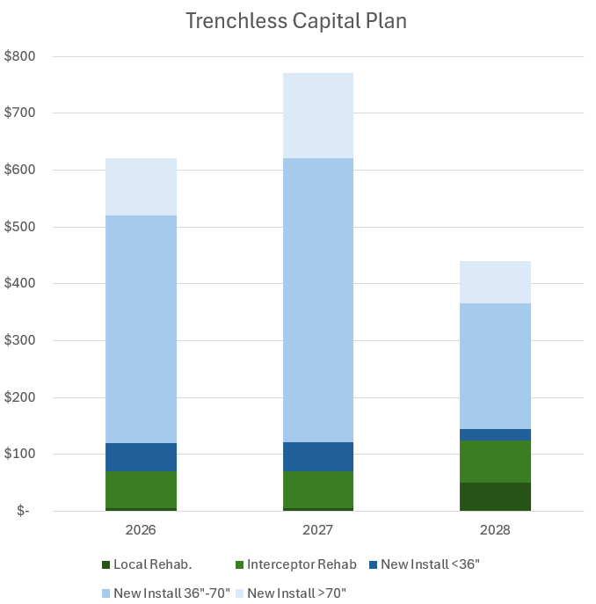
EXAMPLE WATER UTILITY
About EWD
Suggested information to include to orient attendees with your utility
Population served and/or service area
Length of watermains, # pressure zones
Length of wastewater sewers
Total asset value
Average day water supply
Second largest municipality in Example State
[Highlight Topic]
Suggest to highlight the main concerns, ideally related to trenchless, that utility will be managing – addressing adding infrastructure highlighting average asset age or value of assets needing renewal, addressing development or growth, non-revenue water, etc. Opportunities to highlight regulatory or other driving factors.
3-year Wastewater Capital Plan
Additional insight into what types of projects are coming, procurement models, etc.
Key Upcoming Projects for 2026
70” Interceptor Rehab, 2 miles
Procuring Design Phase Q4
CSO Feasibility Study – Q2
54” Microtunnel River Crossing
Tender Phase Q3
Check out our full list of Bids & Tenders
www.EWD.org

